Slide 1

DriverPass
System Analysis
Bryan D. Rodriguez Perez
Notes:
[No speaker notes required for this slide.]

Slide 2

System Requirements
System Requirements
Functional Requirements:
The system must allow students to register for in-person driving lessons.
The system must provide online practice tests and track student progress.
Nonfunctional Requirements:
The system must remain available 24/7 to support flexible student schedules.
The system must protect user data through secure authentication and encrypted storage.
Notes:
For the DriverPass system, I looked at both functional and nonfunctional requirements based on what the client actually needs. Functional requirements are basically what the system has to be able to do. For example, DriverPass needs to let students sign up for in-person driving lessons, and it also needs to offer online practice tests so students can study for their DMV exam. These are some of the main features the client asked for and rely on.
Nonfunctional requirements focus more on how the system works, not just what it does. Since students might use DriverPass at any time of day, the system needs to be available 24/7 so lessons and practice tests are always accessible. Security is also important because the system stores personal and learning information. To protect users, DriverPass needs secure logins and safe handling of data. Together, these requirements help make sure the system is easy to use, dependable, and secure for everyone.

Slide 3
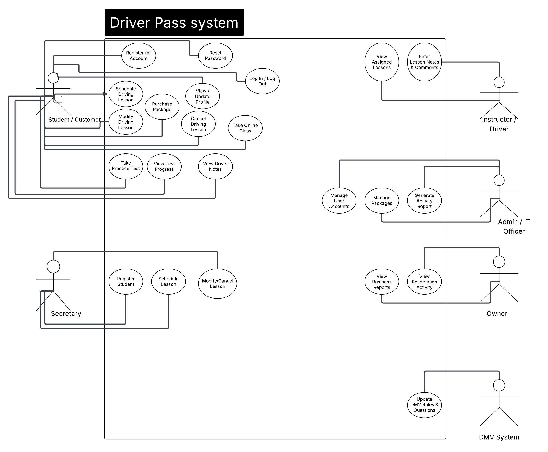
Use Case Diagram
Notes:
This diagram shows the main people who use the DriverPass system and what they can do. Students can schedule driving lessons, take online practice tests, and check their progress as they learn. Instructors use the system to manage their lesson availability, keep track of how students are doing, and write notes after each lesson. Administrators handle the overall system, like managing user accounts and keeping course information up to date.
The goal of this diagram is to make sure the system covers everything DriverPass needs. We focused on features that help students get ready for their driving test, like easy lesson scheduling and online practice. At the same time, the system supports instructors and administrators so everything stays organized and runs smoothly. Laying it out visually helps make sure nothing important is missing.

Slide 4
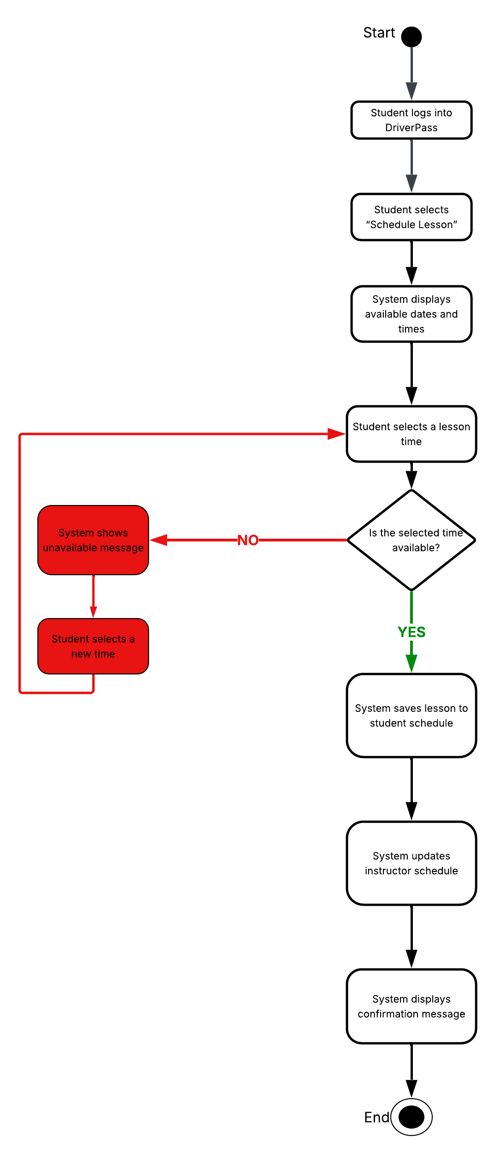
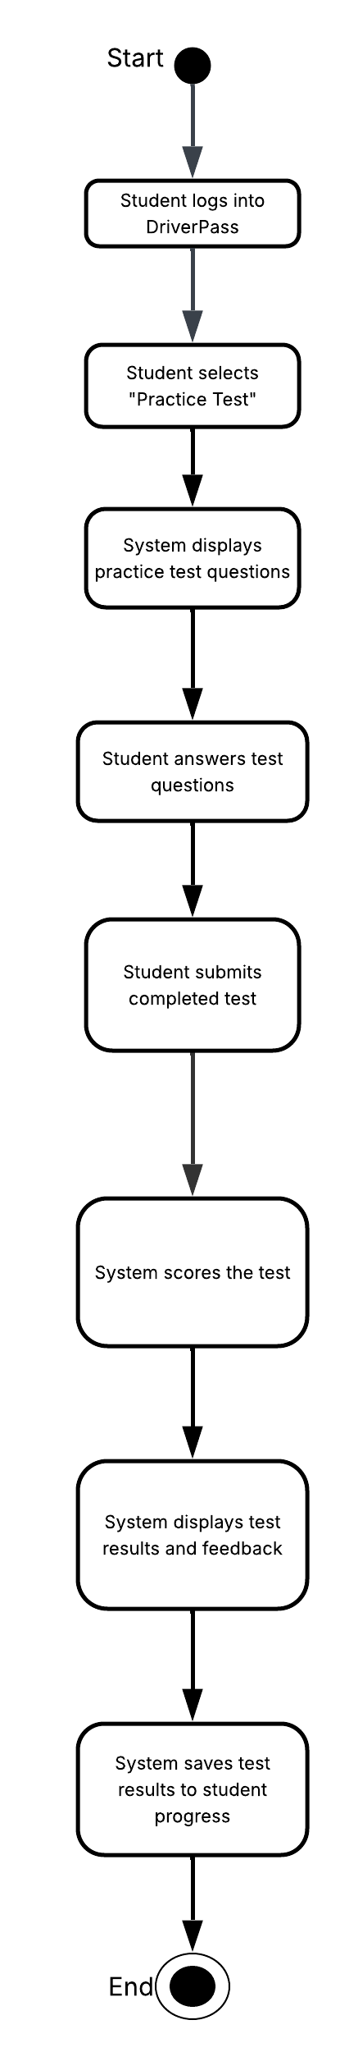
Activity
Diagram
Notes:
This activity diagram shows what happens when a student schedules a driving lesson in the DriverPass system. I picked this process because it’s one of the most important parts of the system and has a big impact on the student’s overall experience.
It starts when the student logs in and chooses the option to schedule a lesson. The system then shows the available dates and times based on the instructor’s schedule. The student picks the time that works best for them, and the system checks to make sure that time is still open. Once it’s confirmed, the lesson is saved to both the student’s schedule and the instructor’s schedule, and the student gets a confirmation message.
This setup keeps lesson scheduling simple and reliable. Students can easily see what’s available, and the system avoids double-booking by checking availability before anything is confirmed. It helps keep students, instructors, and the system all on the same page.
The second activity diagram focuses on taking an online practice test. In this process, the student logs in, selects a practice test, and answers the questions. After the test is submitted, the system scores it, shows the results and feedback, and saves everything to the student’s progress. This helps students see how they’re doing right away and track their improvement as they prepare for the DMV exam.

Slide 5
Security
Secure login required for all users
Personal information protected through safe storage practices
Student and instructor data only visible to authorized users
Regular system maintenance to prevent problems
Backups in place to keep information from being lost
Notes:
Security was an important part of designing the DriverPass system. To protect users, the system requires everyone to sign in before accessing any personal information. This helps prevent unauthorized people from getting into the system. All student and instructor information is stored carefully so that sensitive details stay private and are only visible to the right people.
We also considered the system’s long-term safety. Regular maintenance helps prevent issues, and having routine backups ensures that important data is not lost even if a problem occurs. These steps help DriverPass offer a safe and trustworthy experience for students, instructors, and administrators.

Slide 6
System Limitations
Requires a stable internet connection
Limited by the accuracy of instructor availability updates
Online tests may not perfectly match real DMV exam difficulty
System cannot prevent students from entering incorrect personal information
Some features depend on instructors updating their notes on time
Notes:
Even though the DriverPass system is designed to be helpful and reliable, it does have a few limitations. First, students and instructors need a working internet connection to use the system. If the connection is slow or unavailable, some features may not work as expected.
Another limitation is that the system depends on instructors keeping their availability up to date. If an instructor forgets to adjust their schedule, students may see times that are no longer accurate. The same idea applies to lesson notes—those need to be entered on time so student progress stays accurate.
The online practice tests are designed to help students prepare, but they cannot perfectly match the difficulty or style of the official DMV test. Finally, the system cannot automatically verify every piece of information a student enters, such as their address or phone number. These limitations help set realistic expectations for how the system performs in real-world use.

